Slide 1
Optimizing Converged Cisco Networks (ONT)
Stretnutie 2: Klasifikácia a značkovanie

Slide 2

Základy QoS konfigurácie v IOSe

Slide 3
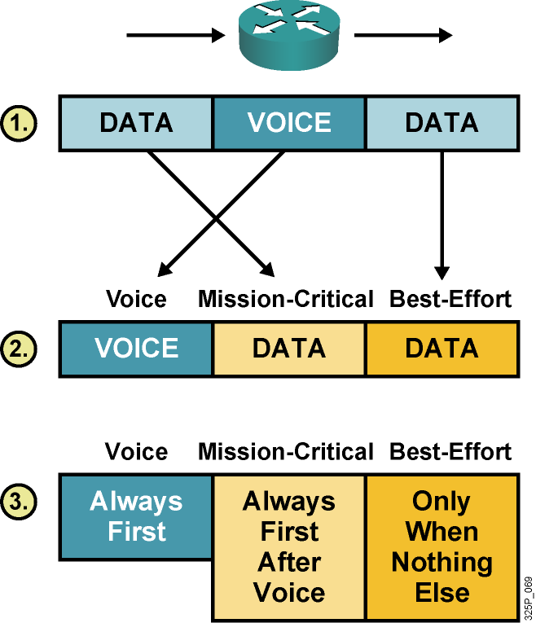
Implementácia QoS prostriedkov
Krok 1: Identifikovať typy prevádzky a ich nároky
Krok 2: Rozdeliť prevádzku do tried podľa nárokov
Krok 3: Definovať QoS pravidlá pre každú triedu
Notes:
Cisco IOS QoS features enable network administrators to control and predictably service a variety of networked applications and traffic types, allowing network managers to take advantage of a new generation of media-rich and mission-critical applications.
There are three basic steps involved in implementing QoS on a network:
Identify types of traffic and their requirements: Study the network to determine the type of traffic that is running on the network and then determine the QoS requirements needed for the different types of traffic.
Define traffic classes: This activity groups the traffic with similar QoS requirements into classes. For example, three classes of traffic might be defined as voice, mission-critical, and best effort.
Define QoS policies: QoS policies meet QoS requirements for each traffic class.

Slide 4
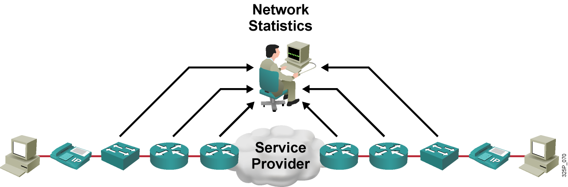
Krok 1: Identifikácia typov prevádzky a ich nárokov
Sieťový audit: Identifikácia prevádzky na sieti
Business audit: Zistiť, akú dôležitosť majú jednotlivé typy prevádzky pre podnik
Nároky na úroveň služieb: Zistiť kladené nároky na jednotlivé služby
Notes:
The first step in implementing QoS is to identify the traffic on the network and then determine the QoS requirements and the importance of the various traffic types. This step provides some high-level guidelines for implementing QoS in networks that support for multiple applications, including delay-sensitive and bandwidth-intensive applications. These applications may enhance business processes, but stretch network resources. QoS can provide secure, predictable, measurable, and guaranteed services to these applications by managing delay, delay variation (jitter), bandwidth, and packet loss in a network.
Determine the QoS problems of users. Measure the traffic on the network during congested periods. Conduct CPU use assessment on each of the network devices during busy periods to determine where problems might be occurring.
Determine the business model and goals and obtain a list of business requirements. This activity helps define the number of classes that are needed and allows you to determine the business requirements for each traffic class.
Define the service levels required by different traffic classes in terms of response time and availability. Questions to consider when defining service levels include what is the impact on business if the network delays a transaction by two or three seconds. A service level assignment will include the priority and the treatment a packet will receive. For example, you would assign voice applications a high service level (high priority, LLQ and RTP compression). You would assign low priority data a lower service level (lower priority, WFQ, TCP header compression).

Slide 5
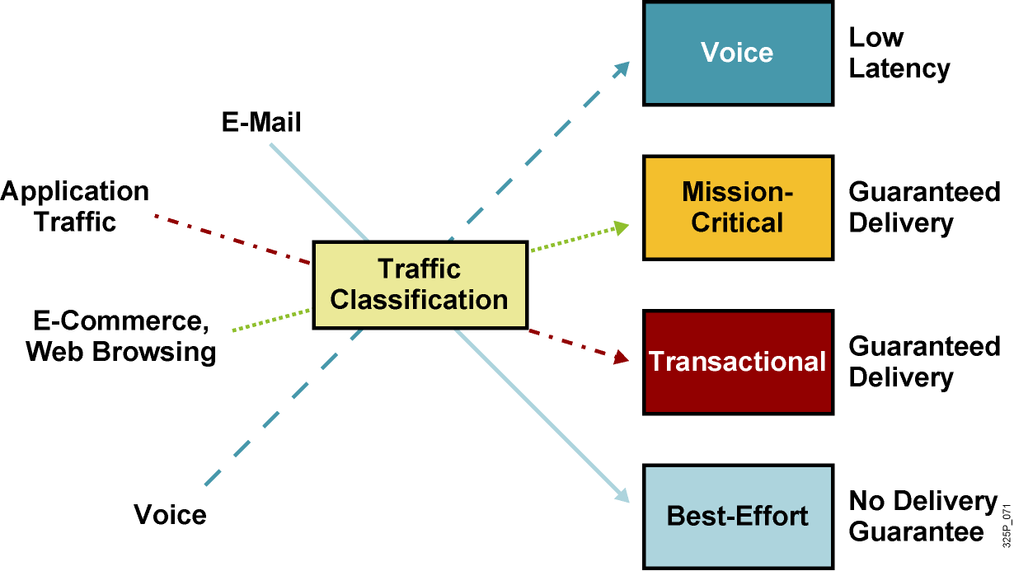
Krok 2: Definovanie tried prevádzky
Scavenger Class
Less than Best Effort
Notes:
After identifying and measuring network traffic, use business requirements to perform the second step: define the traffic classes.
Because of its stringent QoS requirements, voice traffic is usually in a class by itself. Cisco has developed specific QoS mechanisms, such as LLQ, to ensure that voice always receives priority treatment over all other traffic.
After the applications with the most critical requirements have been defined, the remaining traffic classes are defined using business requirements.
A typical enterprise might define five traffic classes:
Voice: Absolute priority for VoIP traffic.
Mission-critical: Small set of locally defined critical business applications. For example, a mission-critical application might be an order-entry database that needs to run 24 hours a day.
Transactional: Database access, transaction services, interactive traffic, and preferred data services. Depending on the importance of the database application to the enterprise, you might give the database a large amount of bandwidth and a high priority. For example, your payroll department performs critical or sensitive work. Their importance to the organization determines the priority and amount of bandwidth you would give their network traffic.
Best effort: Popular applications such as e-mail and FTP could each constitute a class. Your QoS policy might guarantee employees using these applications a smaller amount of bandwidth and a lower priority then other applications. Incoming HTTP queries to your company's external website might be a class that gets a moderate amount of bandwidth and runs at low priority.
Scavenger: The unspecified traffic is considered as less than best effort. Scavenger applications, such as BitTorrent and other point-to-point applications, are served by this class.

Slide 6
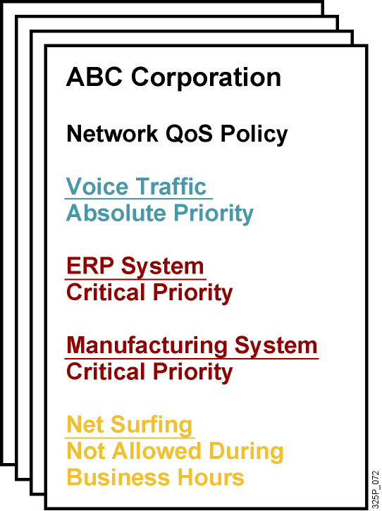
Krok 3: Definovanie QoS pravidiel
QoS pravidlá
Celosieťovo platná definícia, ako majú byť jednotlivé triedy prevádzky obsluhované
Notes:
In the third step, define a QoS policy for each traffic class. Defining a QoS policy involves one or more of these activities:
Setting a minimum bandwidth guarantee
Setting a maximum bandwidth limit
Assigning priorities to each class
Using QoS technologies, such as advanced queuing, to manage congestion
Using the traffic classes, previously defined QoS policies can be mandated based on the following priorities (with Priority 5 being the highest and Priority 1 being the lowest):
Priority 5—Voice: Minimum bandwidth of 1 Mbps. Use LLQ to give voice priority always.
Priority 4—Mission-critical: Minimum bandwidth of 1 Mbps. Use CBWFQ to prioritize critical-class traffic flows.
Priority 3—Transactional: Minimum bandwidth of 1 Mbps. Use CBWFQ to prioritize transactional traffic flows.
Priority 2—Best-effort: Maximum bandwidth of 500 kbps. Use CBWFQ to prioritize best-effort traffic flows that are below mission-critical and voice.
Priority 1—Scavenger (less-than-best-effort): Maximum bandwidth of 100 kbps. Use WRED to drop these packets whenever the network has a tendency toward congestion.

Slide 7
Metódy pre implementovanie QoS
Spôsob | Popis
Legacy CLI | Prostredníctvom CLI Každé rozhranie bolo potrebné konfigurovať nezávisle Náročné, neflexibilné
MQC | Prostredníctvom CLI Využíva modulárny prístup ku konfigurácii Najlepší spôsob
Cisco AutoQoS | Aplikuje QoS nastavenia podľa šablóny Najrýchlejší spôsob, ako implementovať QoS
Cisco SDM QoS wizard | Použiteľný pre jednoduché situácie
Notes:
In the past, the only way to implement QoS in a network was by using the command-line interface (CLI) to configure individual QoS policies at each interface. This is a time-consuming and error-prone task involving cutting and pasting configurations from one interface to another.
Cisco introduced the Modular QoS CLI (MQC) to simplify QoS configuration by making configurations modular. MQC provides a building-block approach that uses a single module repeatedly to apply a policy to multiple interfaces.
Cisco AutoQoS represents innovative technology that simplifies the challenges of network administration by reducing QoS complexity, deployment time, and cost to enterprise networks. Cisco AutoQoS incorporates value-added intelligence in Cisco IOS software and Cisco Catalyst software to provision and assist in the management of large-scale QoS deployments.
Customers can easily configure, manage, and successfully troubleshoot QoS deployments by using the Cisco Router and Security Device Manager (SDM) QoS wizard. The Cisco SDM QoS wizard provides centralized QoS design, administration, and traffic monitoring that scales to large QoS deployments.

Slide 8
Modular QoS CLI – MQC
Novšia, v súčasnosti najpoužívanejšia metóda konfigurácie QoS mechanizmov
Umožňuje vytvárať všeobecné pravidlá, nejedná sá o príkazy viazané na režim rozhraní
Uniformné príkazy pre všetky hlavné Cisco IOS platformy
Uniformná štruktúra príkazov pre všetky QoS nástroje
Oddeľuje klasifikačnú časť od QoS pravidiel
Notes:
The Cisco MQC allows users to create traffic policies and then attach these policies to interfaces. A QoS policy contains one or more traffic classes and one or more QoS features. A traffic class classifies traffic, and the QoS features in the QoS policy determine how to treat the classified traffic.
The Cisco MQC offers significant advantages over the legacy CLI method for implementing QoS. By using MQC, a network administrator can significantly reduce the time and effort it takes to configure QoS in a complex network. Rather than configuring “raw” CLI commands interface by interface, the administrator develops a uniform set of traffic classes and QoS policies that are applied on interfaces.
The use of the Cisco MQC allows the separation of traffic classification from the definition of QoS policy. This capability enables easier initial QoS implementation and maintenance as new traffic classes emerge and QoS policies for the network evolve.

Slide 9
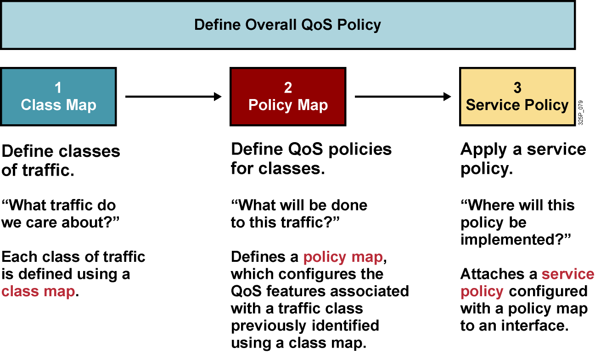
Komponenty MQC
Notes:
This graphic summarizes the three steps to follow when configuring QoS using Cisco MQC configuration. Each step answers a question concerning the classes assigned to different traffic flows:
Build a class map: What traffic do we care about? The first step in QoS deployment is to identify the interesting traffic, that is, classify the packets. This step defines a grouping of network traffic—a class-map in MQC terminology—with various classification tools: Access Control Lists (ACLs), IP addresses, IP precedence, IP Differentiated Services Code Point (DSCP), IEEE 802.1p, MPLS EXP, and Cisco Network Based Application Recognition (NBAR). In this step, you configure traffic classification by using the class-map command.
Policy map: What will happen to the classified traffic? Decide what to do with a group once you identify its traffic. This step is the actual construction of a QoS policy—a policy-map in MQC terminology—by choosing the group of traffic (class-map) on which to perform QoS functions. Examples of QoS functions are queuing, dropping, policing, shaping, and marking. In this step, you configure each traffic policy by associating the traffic class with one or more QoS features using the policy-map command.
Service policy: Where will the policy apply? Apply the appropriate policy map to the desired interfaces, sub-interfaces, or Asynchronous Transfer Mode (ATM) or Frame Relay Permanent Virtual Circuits (PVCs). In this step, you attach the traffic policy to inbound or outbound traffic on interfaces, subinterfaces, or virtual circuits by using the service-policy command.

Slide 10
Krok 1: Vytváranie class-map: “Aká prevádzka nás zaujíma?”
Každá trieda prevádzky je určená nejakou class-map
Class-map má tri hlavné komponenty:
Meno (pozor – je case-sensitive!)
Rad príkazov match
Informáciu, ako vyhodnocovať match príkazy, ak sa ich v mape nachádza viac
Class-map môže pracovať v dvoch režimoch:
Match all: Všetky podmienky je potrebné splniť
Match any: Treba splniť hociktorú podmienky
Predvolený režim je match all
Class-map môžu na seba odkazovať
Využitie boolovskej logiky kombinovaním AND/OR máp pre zložitejšie druhy klasifikácie
Notes:
Step 1 requires you to tell the router what traffic gets QoS and to what degree. An ACL is the traditional way to define any traffic for a router. A class-map defines the traffic into groups with classification templates that are used in policy maps where QoS mechanisms are bound to classes. You can configure up to 256 class maps on a router. For example, you might assign video applications to a class map called Video, and e-mail application traffic to a class map called Mail. You could, you could also create a class map called VoIP traffic and put all VoIP protocols under it.
There are two ways of processing conditions when there is more than one condition in a class map:
Match all: Must meet all conditions to bind a packet to the class.
Match any: Meet at least one condition to bind the packet to the class.
The default match strategy of class maps is match all.

Slide 11
Konfigurácia class-map
Vytvorenie class-map a definovanie režimu
router(config)#
class-map [match-all | match-any] class-map-name
Definovanie testovacích podmienok
router(config-cmap)#
match any
match [ not ] match-criteria
Príklad použitia ACL ako testovacieho kritéria
router(config-cmap)#
match access-group access-list-number
Vhodné je používať aj popisy. Nemenia funkciu class-map
router(config-cmap)#
description description
Notes:
Use the class-map global configuration command to create a class map. Identify class maps with case-sensitive names. All subsequent references to the class map must use the same name. Each class map contains one or more conditions that define which packets belong to the class.
The match commands specify various criteria for classifying packets. Packets are checked to determine whether they match the criteria that are specified in the match commands. If a packet matches the specified criteria, that packet is considered a member of the class and is forwarded according to the QoS specifications set in the traffic policy. Packets that fail to meet any of the matching criteria are classified as members of the default traffic class. The Cisco MQC does not necessarily require that users associate a single traffic class to one traffic policy. Multiple types of traffic can be associated with a single traffic class using the match any command.
The match not command inverts the specified condition. This command specifies a match criterion value that prevents packets from being classified as members of a specified traffic class. All other values of that particular match criterion belong to the class. At least one match command should be used within the class-map configuration mode.
The description command is used for documenting a comment about the class map.

Slide 12
Krok 2: policy-map: “Čo s touto prevádzkou urobíme?”
Policy-map definuje pravidlá, ako sa má nakladať s vybranou triedou sieťovej prevádzky
Triedu určuje class-map
Policy-map má tri hlavné komponenty:
Meno (pozor – case sensitive!)
Odkaz na triedu prevádzky (class-map)
Definíciu QoS pravidiel, ako sa voči tejto prevádzke správať
V jednej policy-map je možné definovať obsluhu až 256 tried prevádzky
Policy-map môžu byť „vhniezdené“ – obsluha jednej konkrétnej triedy môže viesť na odkaz na celú ďalšiu policy-map
Napríklad – globálny shaping a pod ním obsluha jednotlivých tried
Notes:
The policy-map command creates a traffic policy. The purpose of a traffic policy is to configure the QoS features that should be associated with the traffic that is classified into a traffic class or classes. You can then assign as much bandwidth or set whatever priority you need to that class. A traffic policy contains three elements: a case-sensitive name, a traffic class (specified with the class command), and the QoS policies.
The policy-map command specifies the name of a traffic policy (for example, issuing the policy-map class1 command would create a traffic policy named class1). After you issue the policy-map command, you enter policy-map configuration mode. You can then enter the name of a traffic class. You must be in the policy-map configuration mode to enter QoS features that apply to the traffic matching the named class.
A packet can match only one traffic class within a traffic policy. If a packet matches more than one traffic class in the traffic policy, the first traffic class defined in the policy is used.
On the other hand, the Cisco MQC does not necessarily require that you associate only one traffic class to a single traffic policy. When packets match to more than one match criterion, multiple traffic classes can be associated with a single traffic policy. The next topic will explain the concept of nested class maps.

Slide 13
Konfigurácia policy-map
Vytvorenie policy-map
router(config)#
policy-map policy-map-name
Odkaz na vytvorenú class-map. Meno class-default je vyhradené pre ostatnú neklasifikovanú prevádzku
router(config-pmap)#
class {class-name | class-default}
Priamo v policy-map je možné zrýchlene vytvoriť novú triedu nasledujúcim príkazom vrátane podmienky. Režim bude match-all
router(config-pmap)#
class class-name condition
Notes:
You configure service policies with the policy-map command. One policy map can have up to 256 classes using the class command with the name of a preconfigured class map.
This graphic shows the policy-map and class command syntax.
A nonexistent class can also be used within the policy-map configuration mode if the match condition is specified after the name of the class. The running configuration will reflect such a configuration by using the match-any strategy and inserting a full class map configuration.
All traffic that is not classified by any of the class maps that are used within the policy map is part of the default class “class-default.” This class has no QoS guarantees by default. The default class, when used on output, can use one FIFO queue or flow-based WFQ. The default class is part of every policy map, even if a default class is not included in the configuration.

Slide 14
Krok 3: Aplikácia QoS pravidiel: “Kde tieto pravidlá nasadíme?”
Vytvorenú policy-map treba aplikovať na zvolené rozhranie vo vhodnom smere
router(config-if)#
service-policy {input | output} policy-map-name
class-map HTTP
match protocol http
!
policy-map PM
class HTTP
bandwidth 2000
class class-default
bandwidth 6000
!
interface Serial0/0
service-policy output PM
QoS pravidlá sa môžu vzťahovať na vchádzajúcu alebo odchádzajúcu prevádzku
Notes:
Like an ACL, you must apply the policy map to the specific interface you want it to affect. You can apply the policy map in either output or input mode. The last configuration step when configuring QoS mechanisms using the Cisco MQC is to attach a policy map to the inbound or outbound packets using the service-policy command.
Use the service-policy command to assign a single policy map to multiple interfaces or assign multiple policy maps to a single interface (a maximum of one in each direction, inbound and outbound). A service policy can be applied for inbound or outbound packets.
Use the service-policy interface configuration command to attach a traffic policy to an interface and to specify the direction in which the policy should be applied (either on packets coming into the interface or on packets leaving the interface).
The router immediately verifies the parameters that are used in the policy map. If there is a mistake in the policy map configuration, the router displays a message explaining what is wrong with the policy map.
The sample configuration shows how a policy map is used to separate HTTP from other traffic. HTTP is guaranteed 2 Mbps of bandwidth. All other traffic belongs to the default class and is guaranteed to get 6 Mbps of bandwidth.

Slide 15
Príklad kompletnej konfigurácie pomocou MQC
router(config)# class-map match-any business-critical-traffic
router(config-cmap)# match protocol http url “*customer*”
router(config-cmap)# match protocol http url citrix
router(config)# policy-map myqos
router(config-pm am)# class business-critical-traffic
router(config-pm am-c)# bandwidth 1000
router(config)# interface serial 0/0
router(config-if)# service-policy output myqos
1
2
3
Notes:
This graphic is a simple example of using the three-step process. The classification step is modular and independent of what happens to the packet after it is classified.
For example, a defined policy map contains various class maps and the configuration within a policy map can be changed independently from the configuration of a defined class map (and vice versa).
Further, use of the no policy-map command can disable an entire QoS policy.

Slide 16
Ďalší príklad na MQC
hostname Office
!
class-map VoIP
match access-group 100
class-map Application
match access-group 101
!
policy-map QoS-Policy
class VoIP
priority 100
class Application
bandwidth 25
class class-default
fair-queue
!
interface Serial0/0
service-policy output QoS-Policy
!
access-list 100 permit ip any any precedence 5
access-list 100 permit ip any any dscp ef
access-list 101 permit tcp any host 10.1.10.20
access-list 101 permit tcp any host 10.1.10.40
Klasifikácia
QoS pravidlá
QoS obsluha na rozhraní
Klasifikácia
Notes:
An example of the complex configuration tasks involved in using Cisco MQC on the router Office.

Slide 17
Základné príkazy na overenie
Zobrazenie definovaných class-map
router#
show class-map
Zobrazenie definovaných policy-map
router#
show policy-map
Zobrazenie policy-map aplikovaných na rozhraní
router#
show policy-map interface type number
Notes:
To display and verify basic QoS classes and policies configured by using the Cisco MQC, use the commands listed here.

Slide 18

Klasifikácia a značkovanie

Slide 19
Klasifikácia
Klasifikácia je proces indentifikácie a rozdelenia prevádzky do tried, spravidla na základe:
Vstupného rozhrania
Hodnoty IP precedencie
Hodnoty DSCP
Zdrojovej alebo cieľovej adresy
Aplikácie
Bez klasifikácie sa voči paketom chováme rovnako
Klasifikácia sa má realizovať čo najbližšie k zdroju dát
Notes:
Classification is the process of identifying traffic and categorizing that traffic into classes. Classification uses a traffic descriptor to categorize a packet within a specific group to define that packet. After the packet has been classified or identified, the packet is then accessible for QoS handling on the network.
Traffic descriptors that are typically used include:
Incoming interface
IP precedence
Differentiated services code point (DSCP)
Source or destination address
Application
Using classification, network administrators can partition network traffic into multiple classes of service (CoS). When traffic descriptors are used to classify traffic, the source implicitly agrees to adhere to the contracted terms and the network promises QoS. Various QoS mechanisms, such as traffic policing, traffic shaping, and queuing techniques, use the traffic descriptor of the packet (that is, the classification of the packet) to ensure adherence to that agreement.
Classification should take place at the network edge, typically in the wiring closet, within IP phones, or at network endpoints.
Cisco recommends that classification occur as close to the source of the traffic as possible.
NOTE: The term classification is interchangeable with the term packet classification.

Slide 20
Značkovanie
Značkovanie je súčasť QoS nástrojov, ktorý pridelí paketu (rámcu) istú „farbu“, ktorá ho odlišuje od iných paketov (rámcov) pre účely QoS obsluhy
Typicky použité značkovanie:
Linková vrstva:
CoS (ISL, 802.1p)
MPLS EXP (podľa RFC 5462 sa premenúva na „Traffic Class“)
Frame Relay DE (len zahadzovanie)
ATM CLP (len zahadzovanie)
Sieťová vrstva:
DSCP
IP precedencia
Notes:
Marking is related to classification. QoS classification tools categorize packets by examining the contents of the frame, cell, and packet headers; whereas marking tools allow the QoS tool to change the packet headers for easier classification.
Marking involves placing a value into one of the small number of well-defined frame, packet, or cell header fields specifically designed for QoS marking. By marking a packet, other QoS functions can perform classification based on the marked field inside a header. Marking simplifies the network's QoS design, it simplifies configuration of other QoS tools, and it reduces the overhead required by each of the other QoS tools to classify the packets.
Marking a packet or frame with its classification allows subsequent network devices to easily distinguish the marked packet or frame as belonging to a specific class. After the packets or frames are identified as belonging to a specific class, QoS mechanisms can be uniformly applied to ensure compliance with administrative QoS policies.
This slide identifies some commonly used markers at the link layer and network layers.

Slide 21
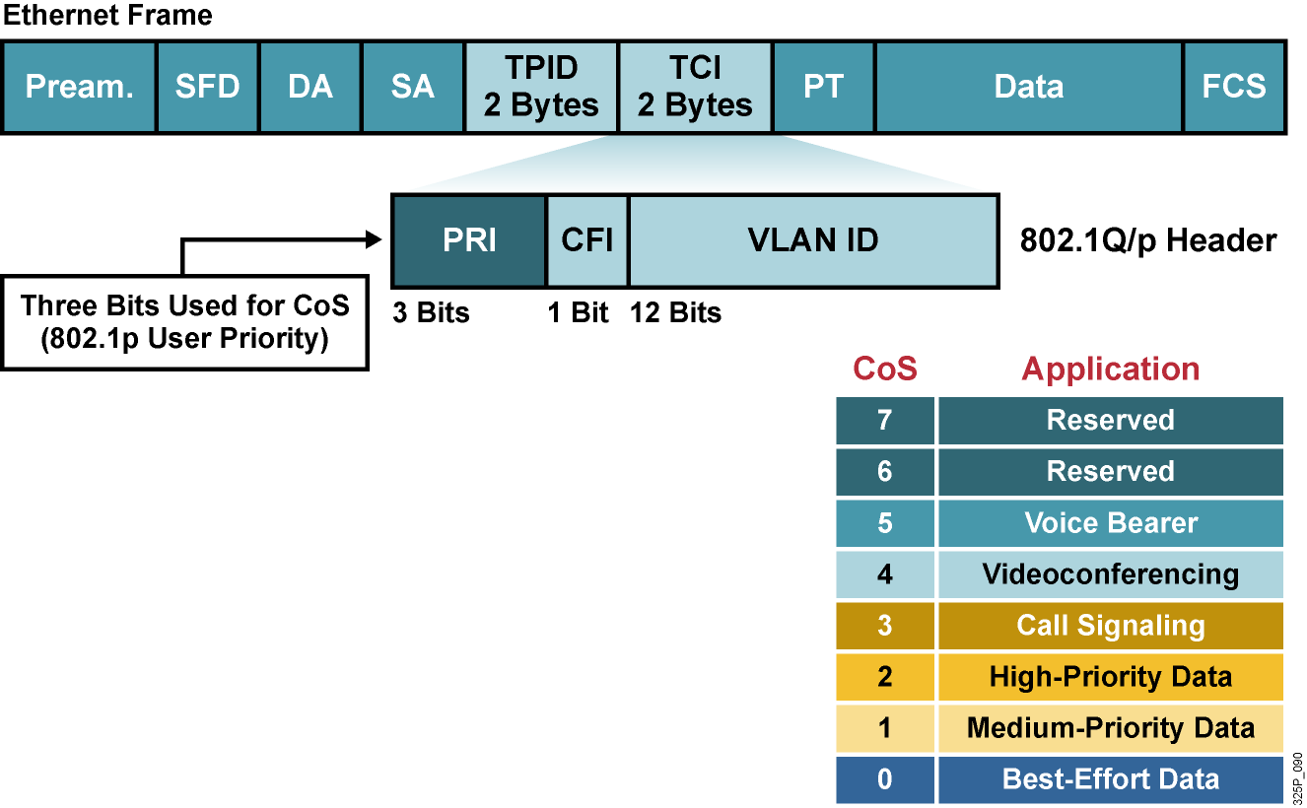
Klasifikácia a značkovanie v IEEE 802.1Q
Pole IEEE 802.1p sa nazýva CoS.
Pri 3 bitoch je možných 8 rôznych priorít
IEEE 802.1p sa zameriava na podporu QoS v LAN a nad 802.1Q
IEEE 802.1p sa zachováva len v rámci LAN, nie po celej trase
Notes:
The 802.1Q standard is an IEEE specification for implementing VLANs in Layer 2 switched networks. The 802.1Q specification defines two 2-byte fields (tag protocol identifier [TPID] and tag control information [TCI]) that are inserted within an Ethernet frame following the source address field.
The TCI field includes 3 bits that are used to identify user priority. These bits can be used to mark packets as belonging to a specific Class of Service (CoS).
The CoS marking allows a Layer 2 Ethernet frame to be marked with eight levels of priority (values 0–7). Three bits allow for 2^3 levels of classification, allowing a direct correspondence with IP version 4 (IPv4) (IP precedence) type of service (ToS) values.
One disadvantage of using CoS markings is that frames lose their CoS markings when transiting a non-802.1Q to a non-802.1p link. Trunking with 802.1Q must be enabled before the CoS field even exists. As soon as the packet encounters Layer 3 forwarding, either with a router or a Layer 3 switch, the old LAN header gets discarded and the CoS field will be lost. Therefore, a ubiquitous permanent marking should be used for network transit. This is typically accomplished by translating a CoS marking into another marker or simply using a different marking mechanism.

Slide 22
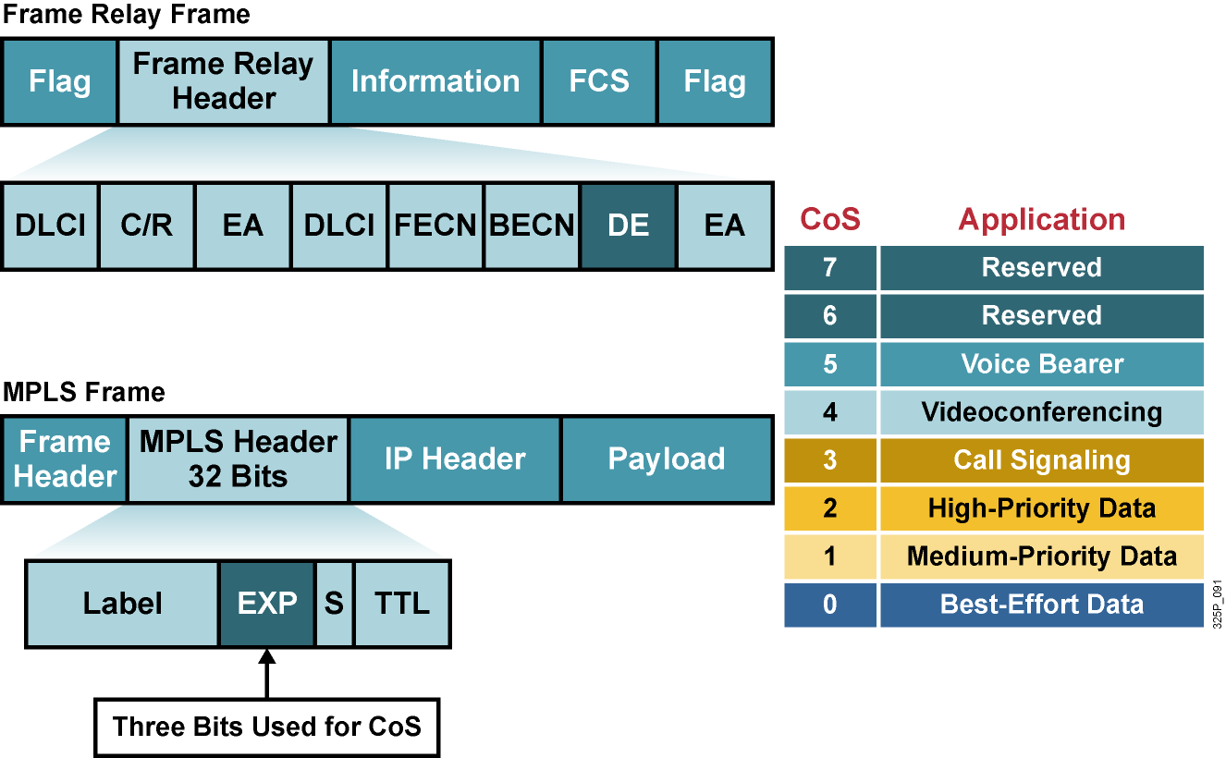
Klasifikácia a značkovanie vo WAN
Notes:
Frame Relay provides a simple set of QoS mechanisms to ensure a committed information rate (CIR): congestion notifications called forward explicit congestion notification (FECN) and backward explicit congestion notification (BECN), in addition to fragmentation of data frames when voice frames are present, as described in Frame Relay Forum standard FRF.12.
One component of Frame Relay QoS is packet discard eligibility when congestion is experienced in the network. Frame Relay will allow network traffic to be sent at a rate exceeding its CIR. The frames that exceed the committed rate can be marked as discard eligible (DE) at the ingress Frame Relay switch. If congestion occurs in the network, frames marked DE will be discarded in preference to frames that are not marked.
When a customer transmits IP packets from one site to another, the IP precedence field (the first three bits of the DSCP field in the header of an IP packet) specifies the CoS. Using IP Precedence, a network administrator can assign values from 0 (the default) to 7 to classify and prioritize types of traffic. Based on the IP precedence marking, the packet is given the desired treatment, such as guaranteed bandwidth or latency. IP Precedence is being phased out in favor of DSCP, but is supported by many applications and routers.
The MPLS experimental bits comprise a 3-bit field that you can use to map IP precedence into an MPLS label. This allows MPLS-enabled routers to perform QoS features indirectly based on the original IP Precedence field inside the IP packets encapsulated by MPLS, without the need to spend resources to look into the IP packet header and examine the IP Precedence field. If the service provider network is an MPLS network, then the IP precedence bits are copied into the MPLS Experimental (EXP) field at the edge of the network.
The MPLS EXP field allows the service provider to provide QoS without overwriting the value in the customer IP Precedence field. The IP header remains available for customer use, and the IP packet marking is not changed while the packet travels through the MPLS network

Slide 23
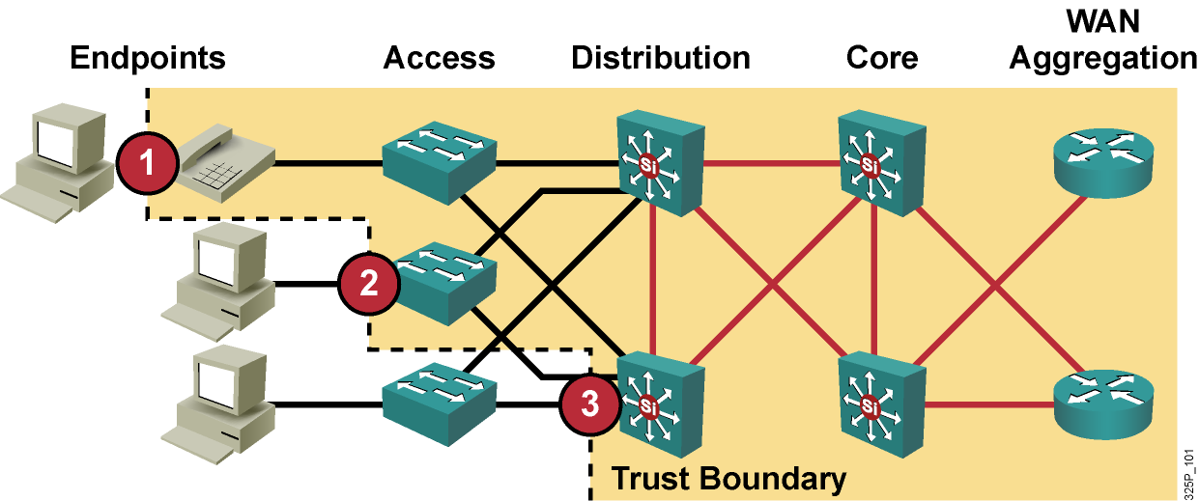
Trust Boundaries: Kde robiť klasifikáciu?
Kvôli škálovateľnosti a dôveryhodnosti by klasifikácia mala byť realizovaná čo najbližšie k okraju siete
Koncové zariadenie
Prístupová vrstva
Distribučná vrstva
Notes:
A trust boundary is the point within the network where markings such as CoS or DSCP begin to be accepted. Previously set markings are overridden as required at the trust boundary.
The location of the trust boundary depends upon the capabilities of the devices connected to the access edge of the LAN. The trust boundary must be implemented at one of three locations in a network as shown:
Endpoint or end system
Access layer
Distribution layer
Trusted endpoints have the capabilities and intelligence to mark application traffic to the appropriate CoS and/or DSCP values. Trusted endpoints also have the ability to re-mark traffic that may have been previously marked by an untrusted device.
If an endpoint is trusted, then the trust boundary should be at the endpoint. When trusted endpoints are connected to a switch port, all that is typically required is enabling the mls qos trust dscp interface command.
If the endpoint is not trusted and the switch in the wiring closet has QoS intelligence, then the trust boundary should be at the access layer—within the switch in the wiring closet.
If the endpoint is not trusted and the switch in the wiring closet does not have QoS intelligence, then the trust boundary should be at the distribution layer—within the switch or router that is aggregating traffic from the access layer.
The concept of trusting or not trusting forms the basis for the trust boundary. Ideally, classification should be done as close to the network edge as possible.

Slide 24
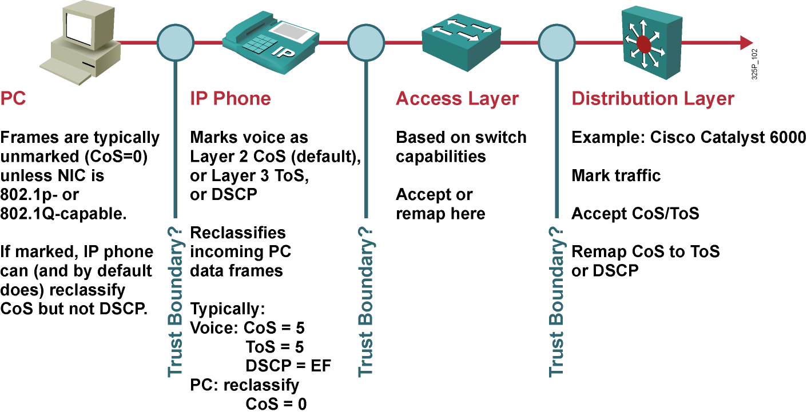
Trust Boundaries: Kde robiť značkovanie?
Notes:
This slide illustrates the challenge of selecting an appropriate place to mark a trust boundary. Classification should take place at the network edge, typically in the wiring closet or within trusted endpoints (such as servers, trusted hosts, video endpoints, or IP telephony devices).
Trusting end users and their PCs is generally not recommended because newer operating systems like Windows XP/Vista and Linux make it relatively easy to set CoS or DSCP markings on PC network interface cards (NICs). Improperly set QoS markings can affect the service levels of users within the enterprise.
IP phones are trusted devices, while PCs are not. This can be a problem when provisioning trust in a mobile environment. For example, port A is configured to trust the endpoint connected to it, which initially is an IP phone. Port B is configured not to trust the endpoint connected to it, which initially is a PC. Because of a move, these endpoints get plugged into the opposite ports. This change breaks the VoIP quality of calls made from the IP phone (now plugged into untrusted port B) and opens the network to unintentional or deliberate abuse of provisioned QoS by the PC (now plugged into the trusted port A).
Cisco switches with QoS intelligence use Cisco Discovery Protocol (CDP) to discover whether any devices plugged into its ports can be trusted. If the device can be trusted (such as a Cisco IP phone), the switch extends trust to the device dynamically. If CDP determines that the device cannot be trusted (such as a PC), the switch does not extend the trust boundary to the device.

Slide 25





Network-Based Application Recognition
NBAR je inteligentný klasifikačný aparát použiteľný s QoS, ktorý:
Rozpoznáva a umožňuje klasifikovať moderné client-server a webové aplikácie
Identifikuje druhy prevádzky na sieti
V reálnom čase analyzuje zloženie prevádzky podľa jednotlivých aplikácií
Class-mapy definované pomocou NBAR možno použiť ako akékoľvek iné
Funkcie NBAR:
Identifikuje aplikácie a protokoly (Layer 4–7)
Realizuje „objavenie“ (discovery) protokolov
Poskytuje štatistiky o prevádzke
Podpora pre rozpoznanie nových aplikácií sa do NBAR pridáva pomocou tzv. PDLM modulov
Môj program ide pomaly!
Citrix 25%
Netshow 15%
Fasttrack 10%
FTP 30%
HTTP 20%
Príklad využitia linky
Notes:
Network-Based Application Recognition (NBAR) is a classification and protocol discovery feature of Cisco IOS software that recognizes a wide variety of applications, including web-based applications and client/server applications that dynamically assign TCP or UDP port numbers.
After NBAR recognizes an application, the network can invoke specific services for that particular application. These features include the ability to guarantee bandwidth to critical applications, limit bandwidth to other applications, drop selective packets to avoid congestion, and mark packets appropriately so that the network and the service provider's network can provide QoS from end to end.
NBAR works with QoS features. NBAR ensures that network bandwidth is used efficiently by classifying packets and then applying QoS to the classified traffic.

Slide 26
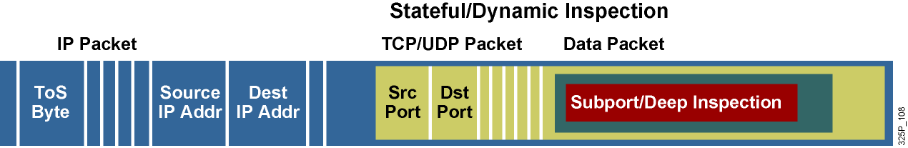
Podpora aplikácií v NBAR
NBAR dokáže rozpoznať aplikácie, ktoré využívajú:
Statické TCP či UDP porty
Protokoly, ktoré nevyužívajú UDP alebo TCP
Dynamicky pridelené TCP a UDP porty, ktoré boli dohodnuté počas vytvorenia spojenia (vyžaduje si tzv. stateful inspection)
Hĺbková klasifikácia na základe obsahu paketov
Notes:
NBAR can classify application traffic by looking beyond the TCP/UDP port numbers of a packet. This is subport classification. NBAR looks into the TCP/UDP payload itself and classifies packets on content within the payload such as transaction identifier, message type, or other similar data.
NBAR recognizes packets belonging to different types of applications:
Static applications establish sessions to well-known TCP or UDP destination port numbers. Such applications, such as Simple Mail Transfer Protocol (SMTP), could also be classified by using access control lists (ACLs).
Some non-IP protocols, such as Novell Internetwork Packet Exchange (IPX), can also be recognized by NBAR.
Dynamic applications use multiple sessions that use dynamic TCP or UDP port numbers. Typically, there is a control session to a well-known port number, and the other sessions are established to destination port numbers negotiated through the control sessions, such as those used with FTP. NBAR inspects the port number exchange through the control session.
NBAR also has the capability to inspect some applications for other information and to classify based on that information. For example, NBAR can classify HTTP sessions based on the requested URL, including MIME type or host name.

Slide 27
Packet Description Language Module
PDLM je súbor, ktorý obsahuje popis protokolu pre jeho rozpoznanie pomocou NBAR
PDLM sa ukladá do FLASH
PDLM je možné pridať za behu bez potreby reštartovať router
PDLM môžu takisto zdokonaliť rozpoznanie už podporovaných protokolov
PDLM sú vytvárané iba spoločnosťou Cisco (nie administrátorom)
router(config)#
ip nbar pdlm pdlm-name
Aktivuje externé PDLM, meno je v URL formáte, napr.: flash://citrix.pdlm
router(config)#
ip nbar port-map protocol-name [tcp | udp] port-number
Definuje porty, na ktorých sa daný protokol má hľadať (najviac 16 portov)
Je možné predefinovať typické porty pre protokoly, alebo k existujúcemu typickému portu pridať nový
Notes:
NBAR supports dynamic upgrades without having to change the Cisco IOS version or restart a router.
Packet Description Language Modules (PDLM) contain the rules that are used by NBAR to recognize an application by matching text patterns in data packets, and they can be used to bring new or changed functionality to NBAR.
An external PDLM can be loaded at run time to extend the NBAR list of recognized protocols. Use PDLMs to enhance an existing protocol-recognition capability. PDLMs allow NBAR to recognize new protocols without requiring a new Cisco IOS image or a router reload.

Slide 28
Mapovanie protokolov na porty v NBAR
router#
show ip nbar port-map [protocol-name]
Zobrazí súčasné priradenie portov a protokolov
Router# show ip nbar port-map
port-map bgp udp 179
port-map bgp tcp 179
port-map cuseeme udp 7648 7649
port-map cuseeme tcp 7648 7649
port-map dhcp udp 67 68
port-map dhcp tcp 67 68
port-map dns udp 53
port-map dns tcp 53
Notes:
Use the show ip nbar port-map command to display the current protocol-to-port mappings in use by NBAR. The protocol-name argument can also be used to limit the display to a specific protocol. Figure [3] shows the command syntax.
After the ip nbar port-map command has been used, the show ip nbar port-map command displays the ports assigned by the administrator to the protocol. If no ip nbar port-map command has been used, the show ip nbar port-map command displays the default ports.

Slide 29
NBAR Protocol Discovery
Funkcia „NBAR Protocol Discovery“ analyzuje existujúcu sieťovú prevádzku v reálnom čase
Identifikuje používané protokoly na sieti
Poskytuje obojsmerné štatistiky o protokoloch na rozhraniach a o používaných protokoloch vôbec
Poskytuje dôležitý monitorovací nástroj:
Generuje prehľady o existujúcej prevádzke v reálnom čase
Informuje o rozdelení prevádzky medzi jednotlivé aplikácie na kľúčových miestach siete
router(config-if)#
ip nbar protocol-discovery
Aktivuje NBAR Protocol Discovery na rozhraní (CEF musí byť vopred aktívne)
Na rozhraní môže, ale nemusí byť použitá service policy (NBAR nezávisí na QoS)
router#
show ip nbar protocol-discovery
Zobrazí získané štatistiky o prevádzke na rozhraniach, kde je NBAR aktivované
Notes:
To develop and apply QoS policies, NBAR includes a protocol-discovery feature that provides an easy way to discover application protocols that are transiting an interface. The feature discovers any protocol traffic supported by NBAR.
NBAR Protocol Discovery captures key statistics associated with each protocol in a network (packet counts, byte counts, and bit rates) on a per interface basis. These statistics define traffic classes and QoS policies for each traffic class. GUI based management tools can graphically display this information, by polling Simple Network Management Protocol (SNMP) statistics from the NBAR Protocol Discovery (PD) Management Information Base (MIB).
NBAR Protocol Discovery can be applied to interfaces and can be used to monitor both input and output traffic. In addition, it shows the mix of applications currently running on the network. This information helps in defining QoS classes and policies, such as how much bandwidth to provide to mission-critical applications, and in determining which protocols should be policed.

Slide 30
Príklad získaných štatistík NBAR
router# show ip nbar protocol-discovery
Ethernet0/0
Input Output
Protocol Packet Count Packet Count
Byte Count Byte Count
5 minute bit rate (bps) 5 minute bit rate (bps)
---------- ------------------------ ------------------------
realaudio 2911 3040
1678304 198406
19000 1000
http 19624 13506
14050949 2017293
0 0
<output omitted>
Notes:
NBAR Protocol Discovery can monitor both input and output traffic and can be applied with or without a service policy enabled. NBAR Protocol Discovery gathers statistics for packets switched to output interfaces. These statistics are not necessarily for packets that exited the router on the output interfaces, because packets might have been dropped after switching for various reasons (policing at the output interface, ACLs, or queue drops).
The example here displays partial output of the show ip nbar protocol-discovery command for an Ethernet interface.

Slide 31
Využitie NBAR v QoS nástrojoch
Postup konfigurácie:
Ak je to potrebné, aktivovať externé PDLM moduly
Aktivovať NBAR Protocol Discovery
Osobne si myslím, že toto tvrdenie nie je pravdivé
Vytvoriť class-map, v ktorej využijeme NBAR
Vytvoriť príslušnú policy-map
Aplikovať policy-map na rozhranie
router(config-cmap)#
match [not] protocol meno-protokolu
Notes:
The ability of NBAR to classify traffic by protocol and then apply QoS to that traffic uses the MQC class map match criteria. The following steps, are required to successfully deploy NBAR for static protocols:
Enable NBAR Protocol Discovery.
Configure a traffic class.
Configure a traffic policy.
Attach the traffic policy to an interface.
Enable PDLM if needed.

Slide 32
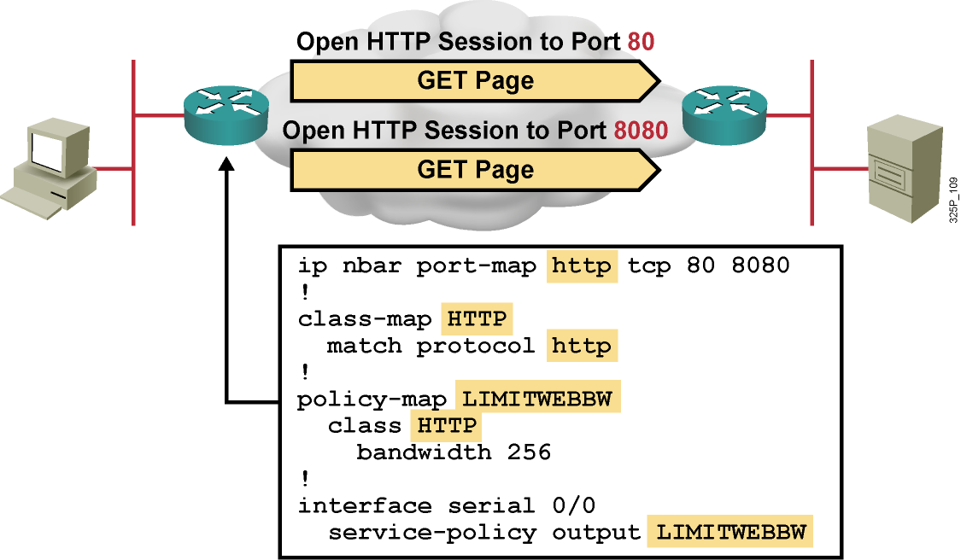
Príklad využitia NBAR
HTTP bežne beží na TCP porte 80, avšak v tomto príklade je identifikovaný aj na porte 8080 pomocou pridania príkazu ip nbar port-map
Ak sa má protokol hľadať aj na typickom porte, treba ho uviesť
Notes:
This is an example of using the ip nbar port-map command. HTTP is often used on other port numbers. The example shows the usage of the ip nbar port-map command to also enable HTTP recognition on TCP port 8080.
The NBAR port map is configured for HTTP for TCP ports 80 and 8080.
The class map called “HTTP” is used to match the HTTP protocol. The policy map called “LIMITWEBB” will use the class map HTTP and set the bandwidth for HTTP traffic to 256 kbps.
The policy map is then applied as a service policy for outbound traffic on serial0/0.

Slide 33
Regulárne výrazy
Znak | Význam
* | Vracia zhodu s hocijakou, i prázdnou skupinou znakov *cia = cia, funkcia, relacia, ambivalencia, insuficiencia, …
? | Vracia zhodu s ľubovoľným jedným znakom c?slo = caslo, cbslo, ccslo, …
| | Vracia zhodu s jedným zo znakov v danej alternatíve pa|eter = pater, peter
(|) | Vracia zhodu s jednou zo skupín znakov v danej alternatíve picture.(gif|jpg) = picture.gif, picture.jpg
[ ] | Vracia zhodu s jedným zo znakov v danom intervale znakov alebo so špeciálnym znakom [0-9] = 0, 1, 2, 3, 4, 5, 6, 7, 8, 9 [prst] = p, r, s, t [a-e] = a, b, c, d, e [*] = * (znak) [[] = [ (znak)
Notes:
The table lists various regular expressions and their description.
The following example configures NBAR to match all FastTrack traffic:
match protocol fasttrack file-transfer "*"
In the next example, all FastTrack files that have the .mpeg extension will be classified into class map nbar.
class-map match-all nbar
match protocol fasttrack file-transfer "*.mpeg"
The following example configures NBAR to match FastTrack traffic that contains the string “cisco”:
match protocol fasttrack file-transfer "*cisco*"

Slide 34
Pokročilé možnosti NBAR klasifikácie pre HTTP
router(config-cmap)#
match protocol http url url-string
Hľadá HTTP GET pakety, v ktorých sa objavuje zadané URL, a potom vracia zhodu na všetky ďalšie pakety, ktoré súvisia s danou jednou HTTP konverzáciou s týmto hostiteľom
url-string má obsahovať iba cestu za menom servera alebo jej podreťazec (napr. http://www.cisco.com/go/certifications)
url-string môže obsahovať regulárne výrazy
router(config-cmap)#
match protocol http host hostname-string
router(config-cmap)#
Hľadá v HTTP pakete pole „Host“, ktoré obsahuje daný (pod)reťazec a vracia zhodu na všetky ďalšie pakety, ktoré súvisia s danou jednou HTTP konverzáciou s týmto hostiteľom
hostname-string môže obsahovať regulárne výrazy
Notes:
NBAR has enhanced classification capabilities for HTTP. It can classify packets belonging to HTTP flows based on the following:
The URL portion after the host name, which appears in the GET request of the HTTP session
The host name specified in the GET request
The following example classifies, within the class map called “class1,” HTTP packets based on any URL containing the string “whatsnew/latest” followed by zero or more characters:
class-map class1
match protocol http url whatsnew/latest*
The next example classifies, within the class map called “class2,” packets based on any host name containing the string “cisco” followed by zero or more characters:
class-map class2
match protocol http host cisco*

Slide 35
Pokročilé možnosti NBAR klasifikácie pre HTTP, FastTrack a Gnutella toky
router(config-cmap)#
match protocol http mime MIME-type
Hľadá HTTP paket, v ktorom sa uvádza daný MIME typ obsahu, a vracia zhodu na všetky ďalšie pakety, ktoré súvisia s danou jednou HTTP konverzáciou s týmto hostiteľom
MIME-type môže obsahovať regulárne výrazy
router(config-cmap)#
match protocol { fasttrack | gnutella } file-transfer regulárny-výraz
Stavový mechanizmus na identifikáciu celého radu peer-to-peer aplikácií pre zdieľanie súborov
regulárny-výraz popisuje tvar mena súboru, prenos ktorého sa sleduje. Znak „*“ označuje hociaký súbor
Notes:
NBAR supports a wide range of network protocols, including the stateful protocols that were difficult to classify before. Stateful protocols such as HTTP or FastTrack applications need special configuration to use the NBAR feature.
NBAR offers the ability to match packets containing a specified MIME type.
The following example classifies, within the class map called “class3,” packets based on the JPEG MIME type:
class-map class3
match protocol http mime "*jpeg"
Applications that use the FastTrack peer-to-peer protocol include Kazaa, Grokster, and Morpheus (although newer versions of Morpheus use Gnutella).
A regular expression is used to identify specific FastTrack traffic. For instance, entering “cisco” as the regular expression would classify the FastTrack traffic containing the string “cisco” as a match for the traffic policy.

Slide 36
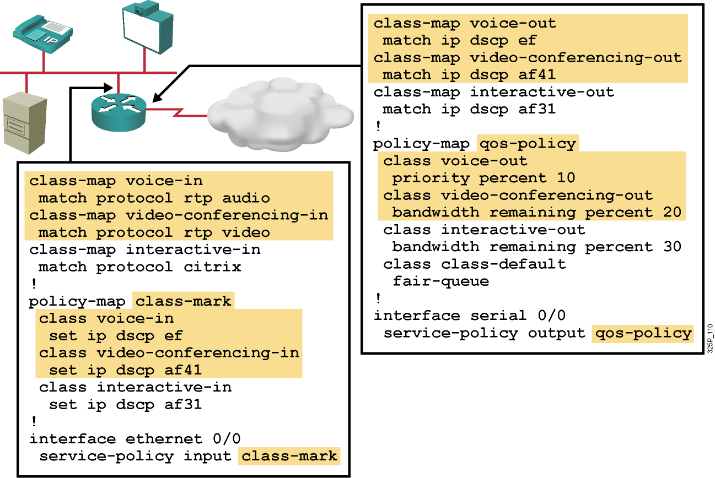
Príklad klasifikácie RTP pomocou NBAR
Notes:
The example shows a simple classification of RTP sessions, both on the input interface and on the output interface of the router.
On the input interface, three class maps have been created: voice-in, videoconferencing-in, and interactive-in. The voice-in class map will match the RTP audio protocol, the videoconferencing-in class map will match the RTP video protocol, and the interactive-in class map will match the Citrix protocol.
The class-mark policy map will then do the following:
If the packet matches the voice-in class map, the packet differentiated services code point (DSCP) field will be set to Expedited Forwarding (EF). If the packet matches the videoconferencing-in class map, the packet DSCP field will be set to Assured Forwarding (AF) 41. If the packet matches the interactive-in class map, the DSCP field will be set to AF 31.
The class-mark policy map is applied to the input interface, Ethernet 0/0.
On the output interface, three class maps have been created: voice-out, videoconferencing-out, and interactive-out. The voice-out class map will match the DSCP field EF. The videoconferencing-out class map will match the DSCP field AF 41. The interactive-out class map will match the DSCP field AF 31.
As shown in the figure, the qos-policy policy map will then do the following:
If the packet matches the voice-out class map, the packet priority will be set to 10 percent of the bandwidth. If the packet matches the videoconferencing-out class map, the packet priority will be set to 20 percent of the bandwidth. If the packet matches the interactive-out class map, the packet priority will be set to 30 percent of the bandwidth. All other packets will be classified as class-default and fair queuing will be performed on them.
The class-mark policy map is applied to the output interface, serial 0/0.

